Slide 1

Dragon Ball Shooters
2
+

Slide 2

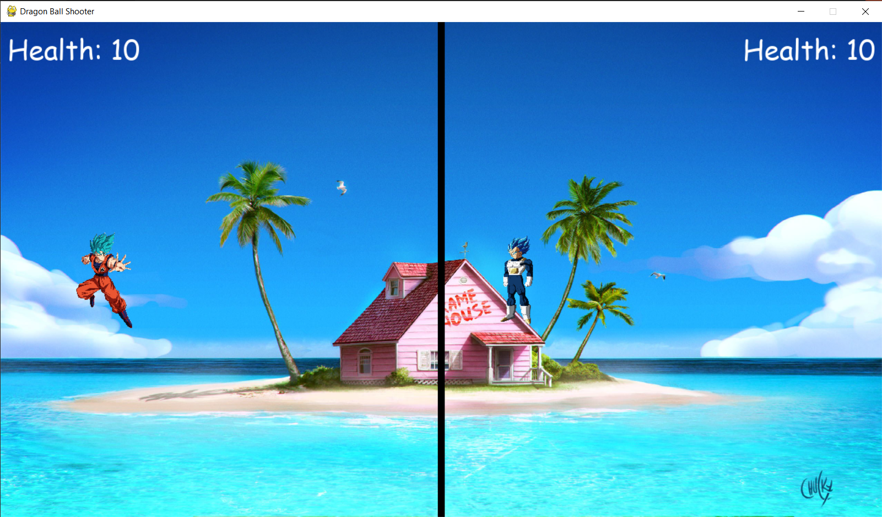
What is this Game?
2
+
The infamous battle between kakarot and vegeta
Two player game against each other
A border which restricts the playing field for each character
They fire projectiles and if the hit the target then their health goes down
After health reaches 0 a winner is declared.

Slide 3
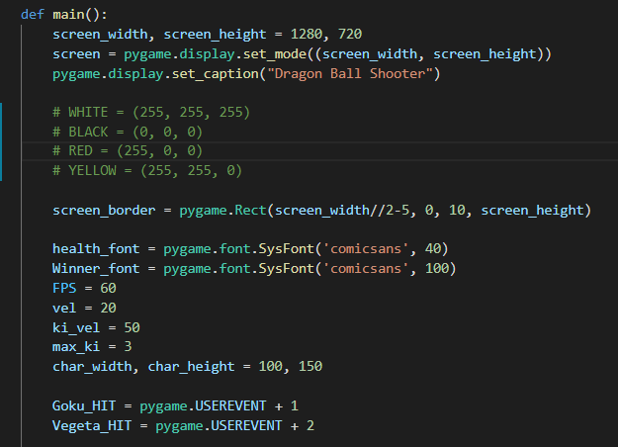
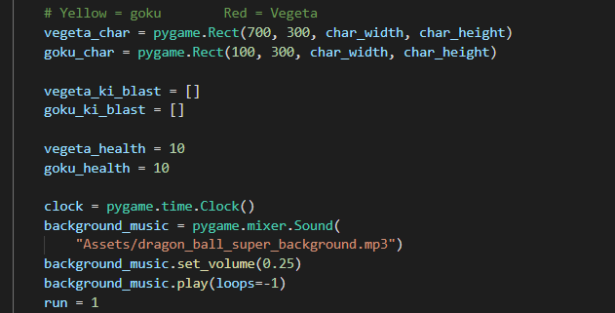
Declaration

Slide 4
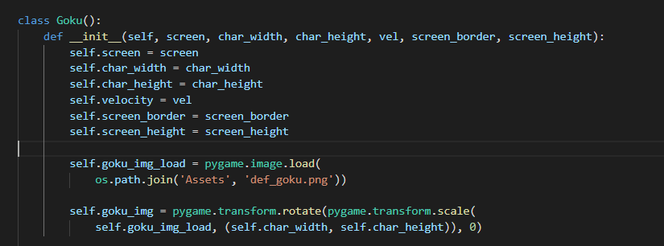
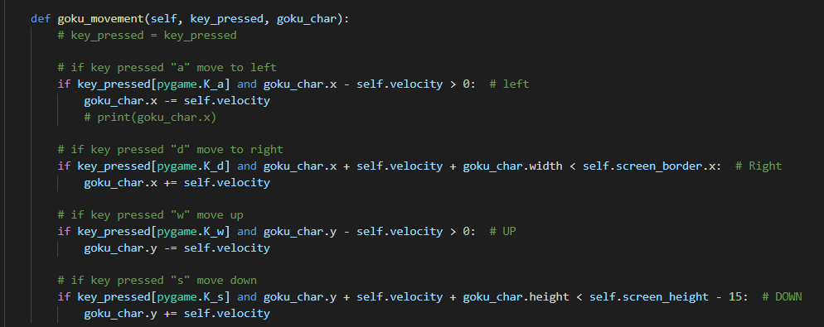

Slide 5
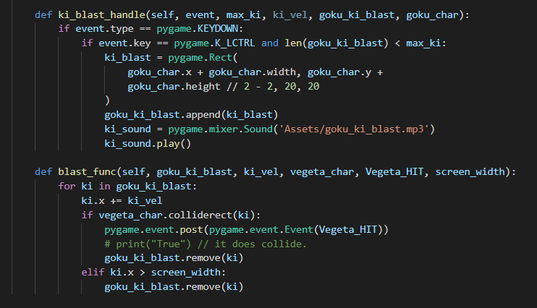
Ki blast
When a key is pressed down (left CTRL) in our case.
And with condition that there are only 3 projectiles (so players don’t just spam)
then create a Rect and store it’s positions and append it to the empty list for Goku we defined earlier.
We also add audio effects when the key is pressed.
2
+
Blast function
This handles the collision
And also removes the projectiles either when they hit the target or leaves the screen border

Slide 6
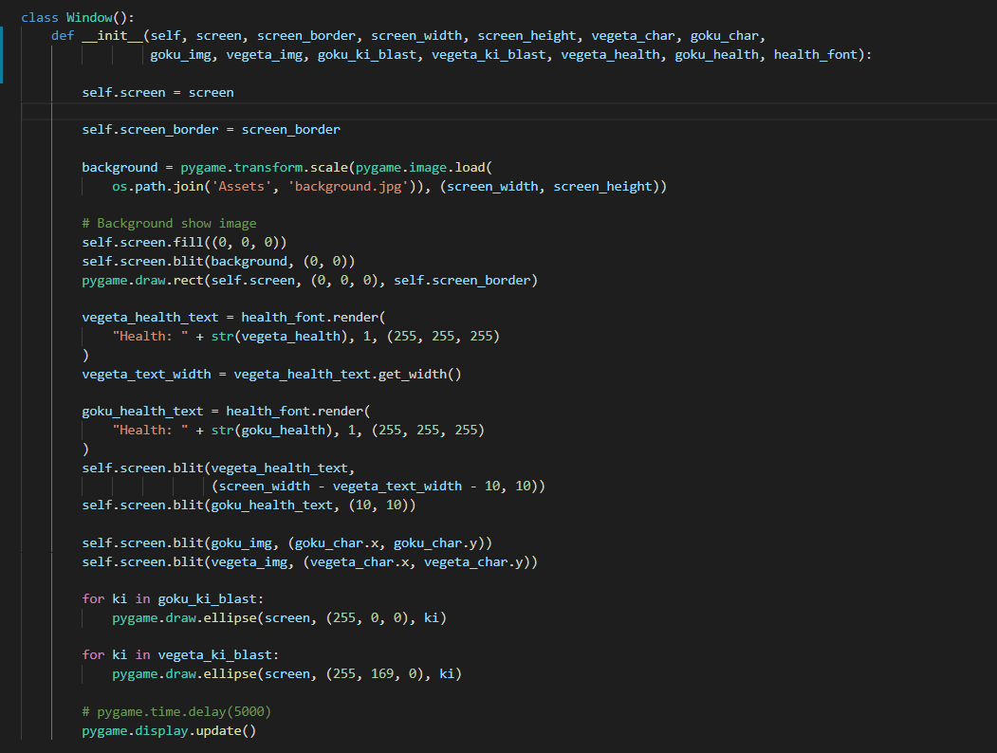
2
+
This class all the content which gets displayed on the screen
Content like background, health, the characters themselves, also drawing the projectiles
And updates

Slide 7
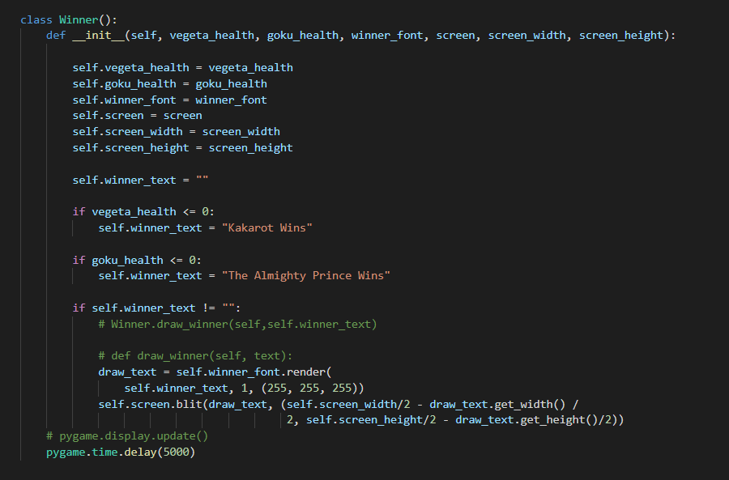
2
+
This final class will display the Winner message

Slide 8
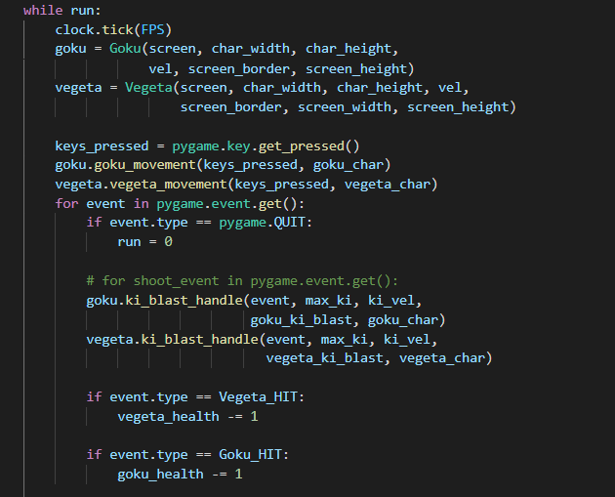
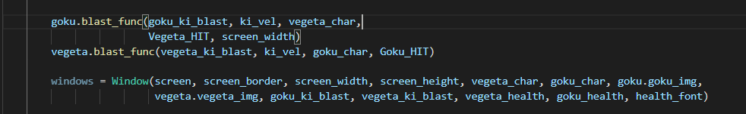

Slide 9
DEMO
2
+
2
+

Slide 10
THANK YOU
2
+
2
+

